Slide 1
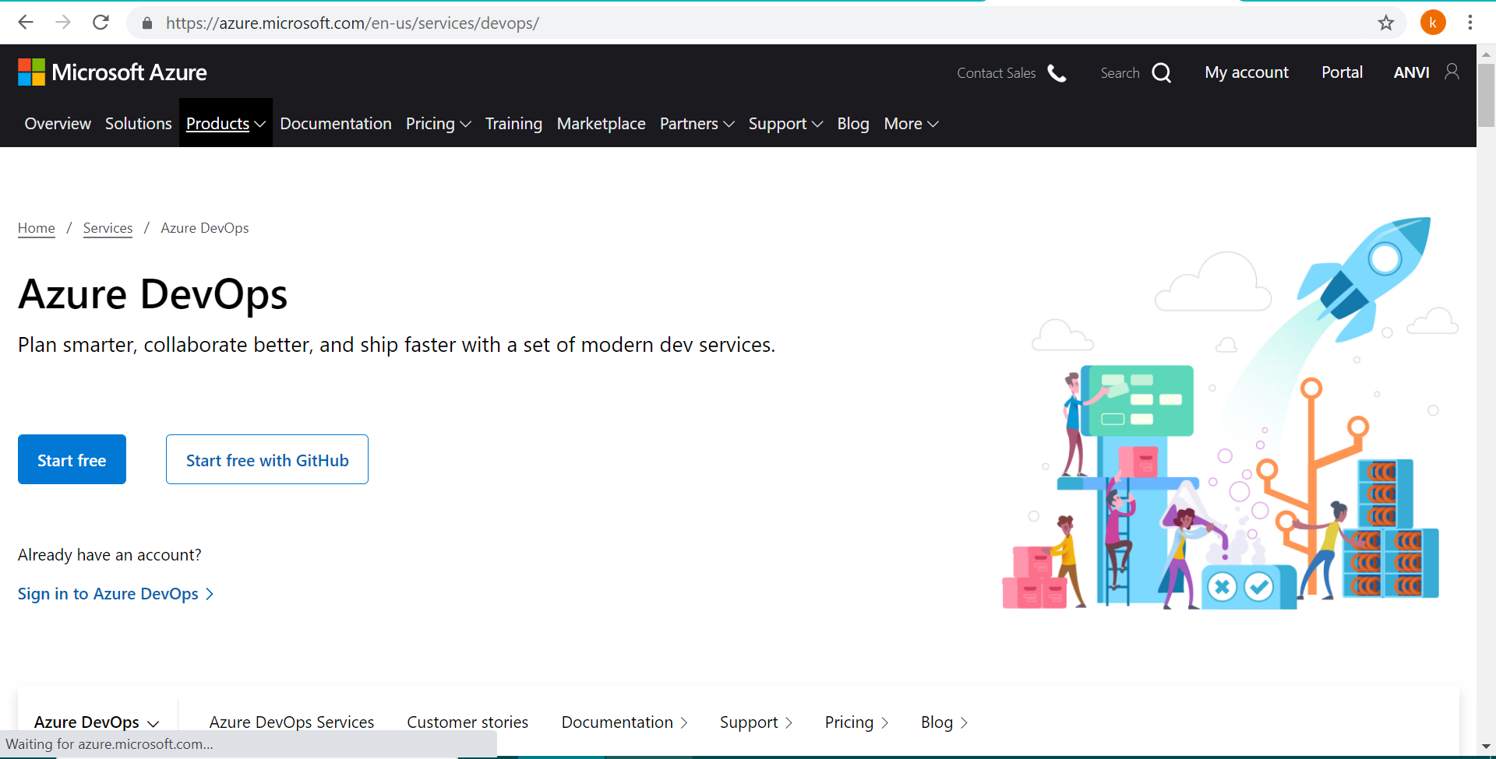

Slide 2
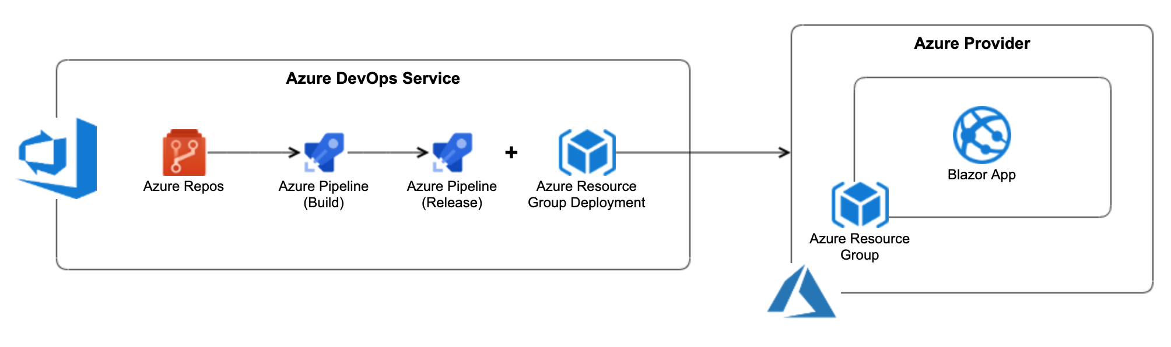
What are Azure Pipelines?

Slide 3
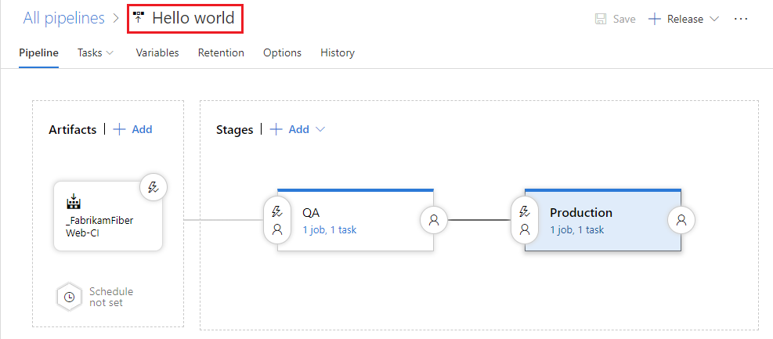
What are Azure Pipelines?

Slide 4

What are Azure Pipelines?

Slide 5
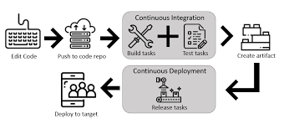
What are Azure Pipelines?

Slide 6
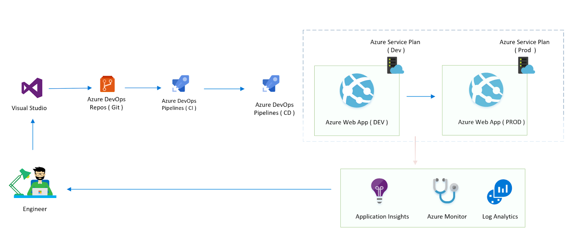
What are Azure Pipelines?

Slide 7
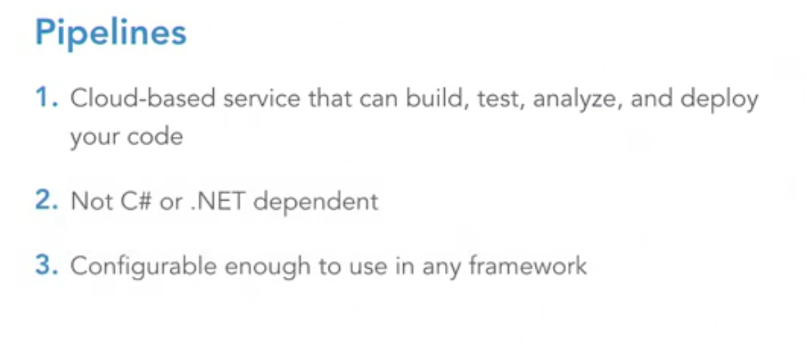
What are Azure Pipelines?

Slide 8
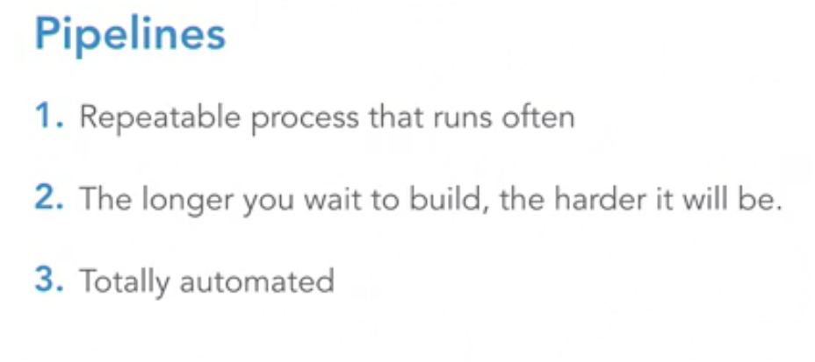
What are Azure Pipelines?

Slide 9
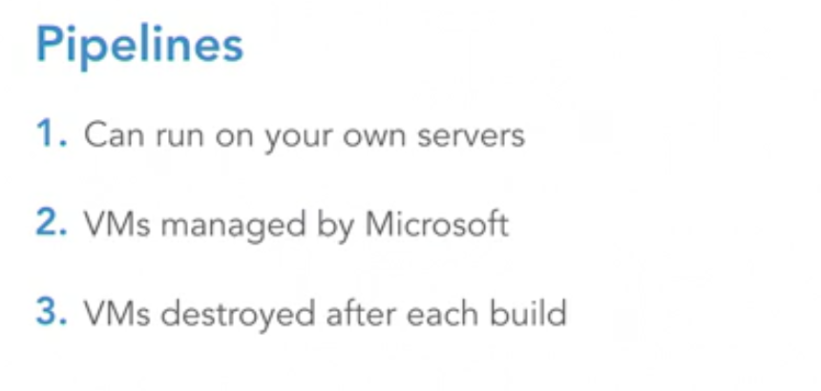
What are Azure Pipelines?

Slide 10
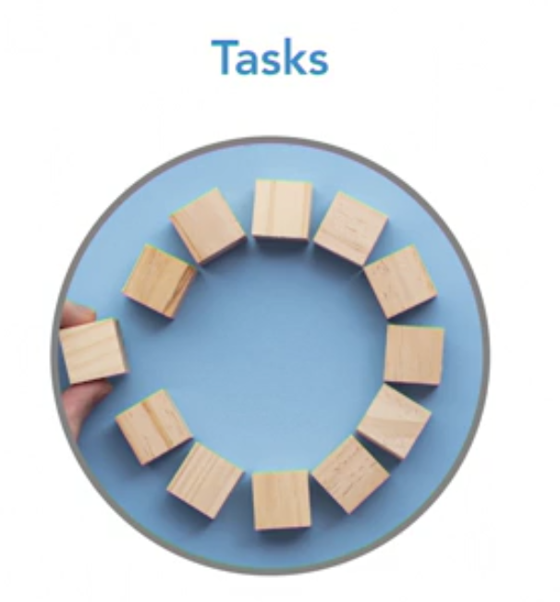
What are Azure Pipelines?

Slide 11
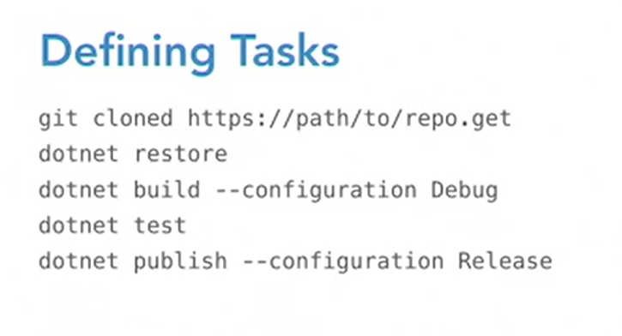
What are Azure Pipelines?

Slide 12
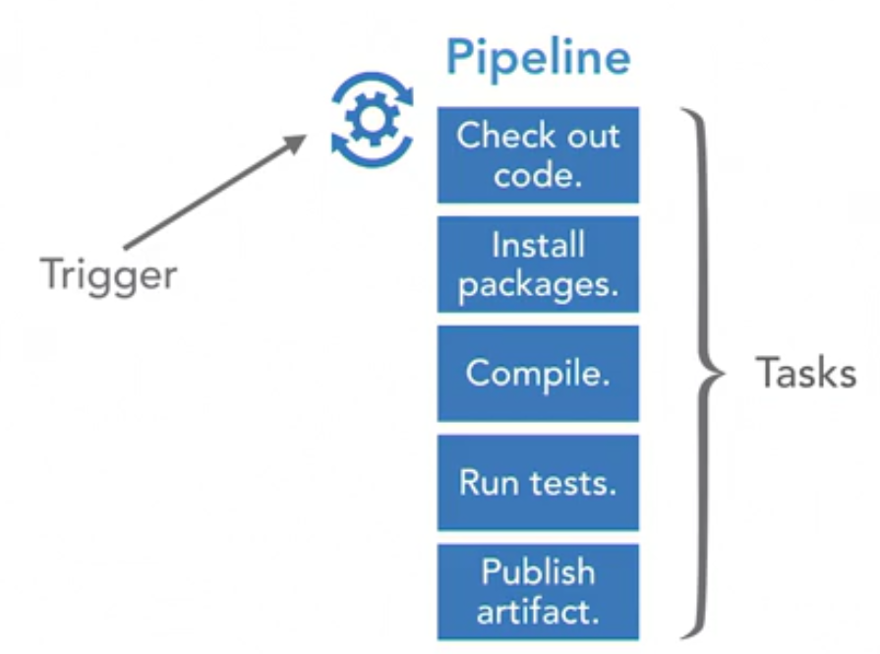
What are Azure Pipelines?

Slide 13
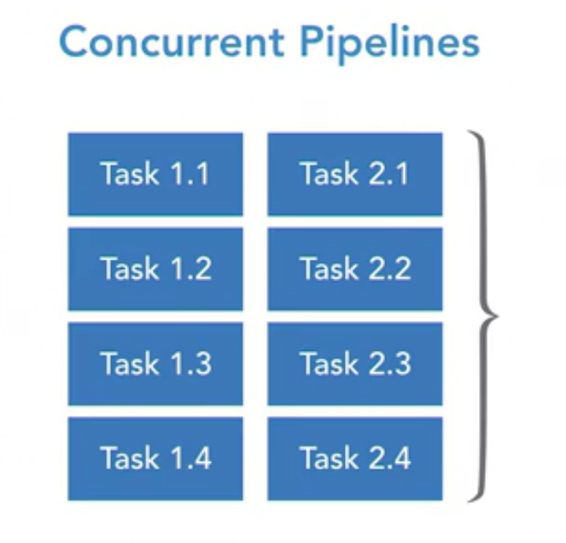
What are Azure Pipelines?

Slide 14
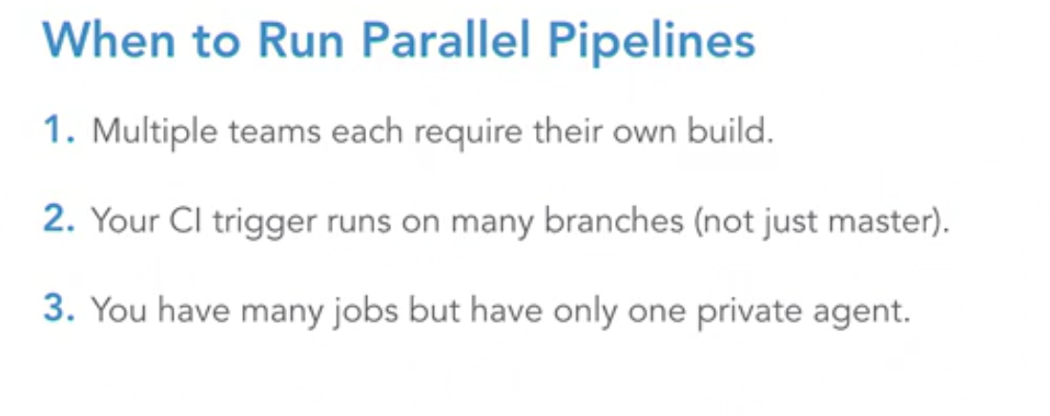
What are Azure Pipelines?

Slide 15
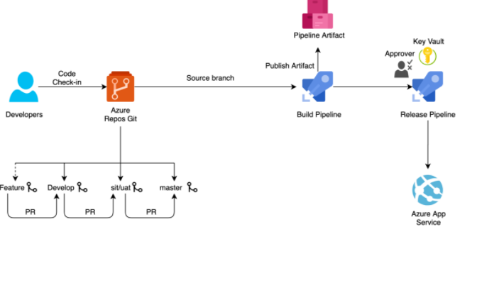
What are Azure Pipelines?

Slide 16
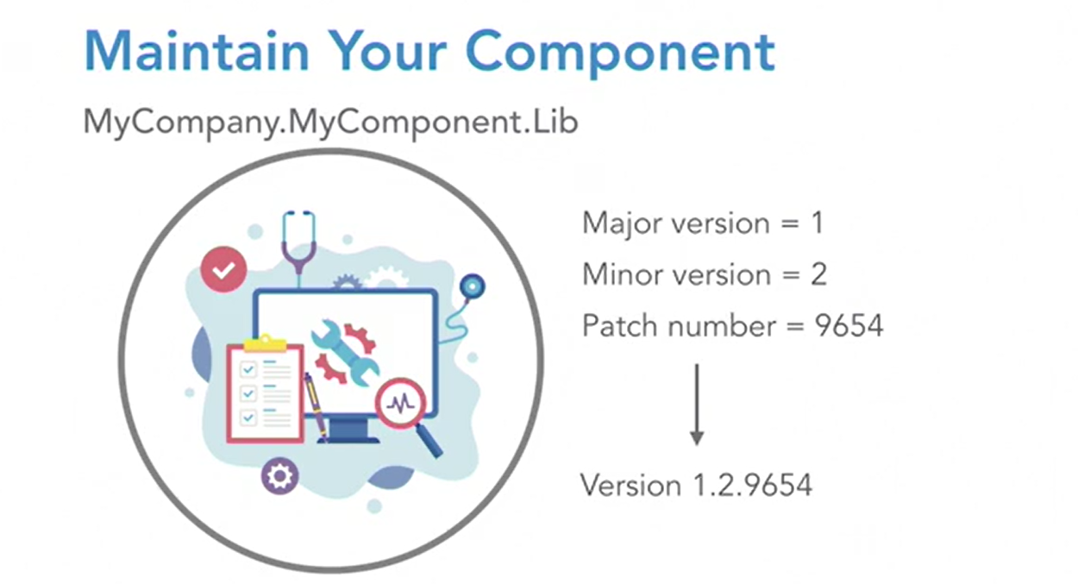

Slide 17
Start
Code
Line1
Line2
Line3
Line4
Line5
………
Code Repo
Unit Testing
Another Report
End

Slide 18
Src/pom
Azure Repos
Artifacts
CentOS 7 in VM
Build
Azure DevOps Agent Pool
Azure Pipeline
Build
Azure Pipeline
Deploy
IE Hello World
Dev*Web App

